Slide 1
EXPANSIVE CLAY PROBLEMS IN TRANSPORTATION GEOTECHNICS: SITE INVESTIGATION, PERFORMANCE MONITORING AND SUSTAINABLE SOLUTIONS
Dr. Sadik Khan, P.E. (JSU)
Dr. Sahadat Hossain, P.E. (UTA)
Asif Ahmed, (UTA)
Mohammad Faysal (UTA)

Slide 2
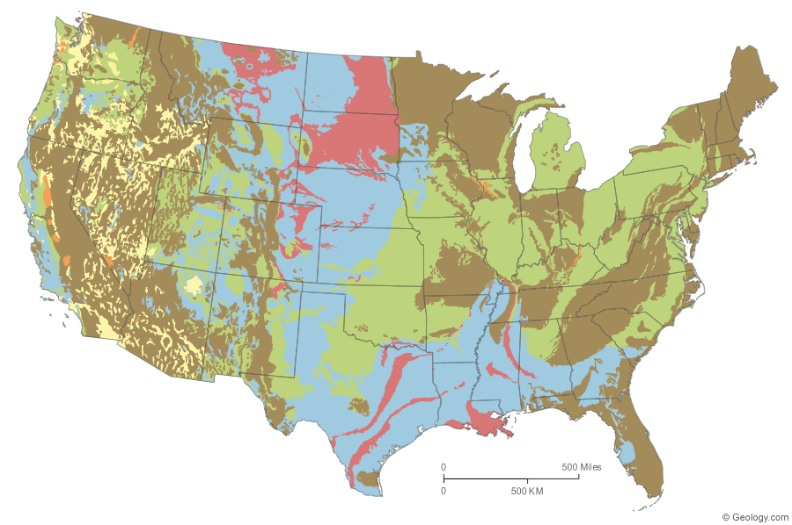
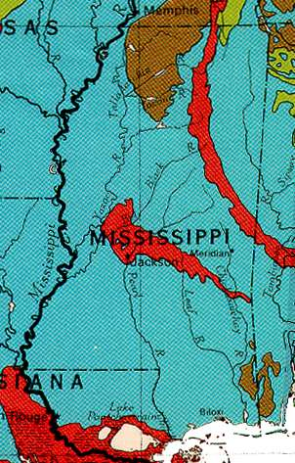
Expansive Clay in US
Legend:
Red: Clay having high swelling potential
Blue: Less than 50% of clay contents having high swelling potential
Orange: Clay content having slight to moderate swelling potential
Green: Less than 50% of clay contents having slight to moderate swelling potential
Brown: Little or no swelling clay
Yellow: Insufficient data

Slide 3
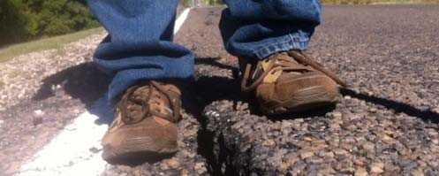
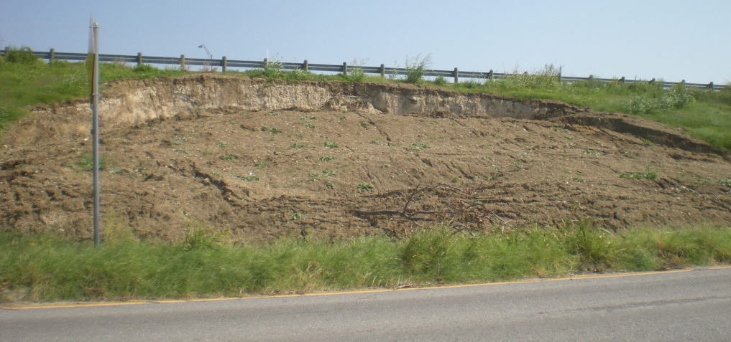
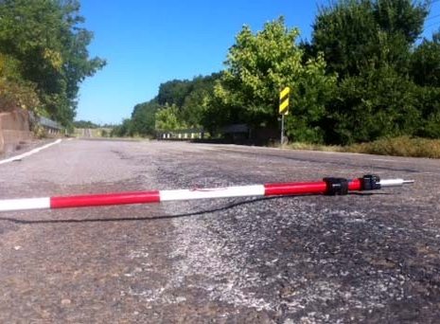
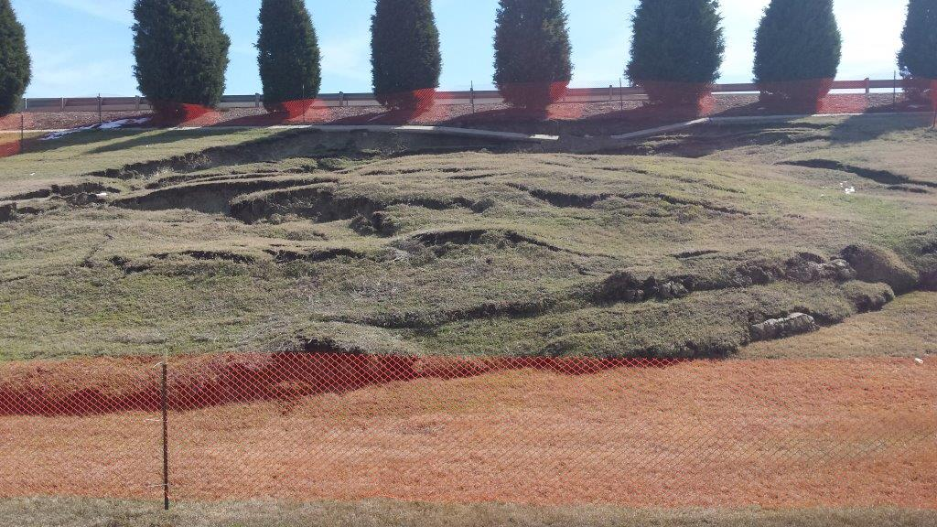
Expansive Clay problems in Transportation Geotechnics

Slide 4
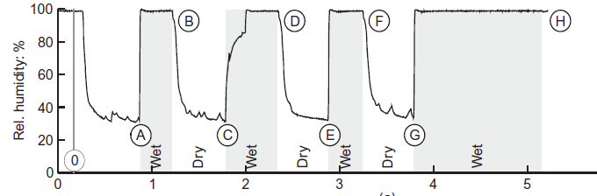

Major Engineering Problems of Expansive Clay
Peak O-C
Fully Softened
Peak N-C
Shear Stress
EVAPOTRANSPIRATION
Residual
PAVEMENTFOUNDATION
WATER CONTENT
(COVERED)
Displacement
ACTIVE ZONE
WATER CONTENT PROFILE WITH E.T.
HYDROSTATIC WATER CONTENT PROFILE
DRY SEASON
WET SEASON
Volume Change of Soil
Decrease in Soil Strength
Pavement Distress
Slope Failure

Slide 5
Presentation Outline
Instrumentation and performance evaluation of pavement subgrade on expansive soil
Sustainable stabilization of the highway slope failure over expansive soil.

Slide 6
INSTRUMENTATION AND PERFORMANCE EVALUATION OF PAVEMENT SUBGRADE ON EXPANSIVE SOIL

Slide 7
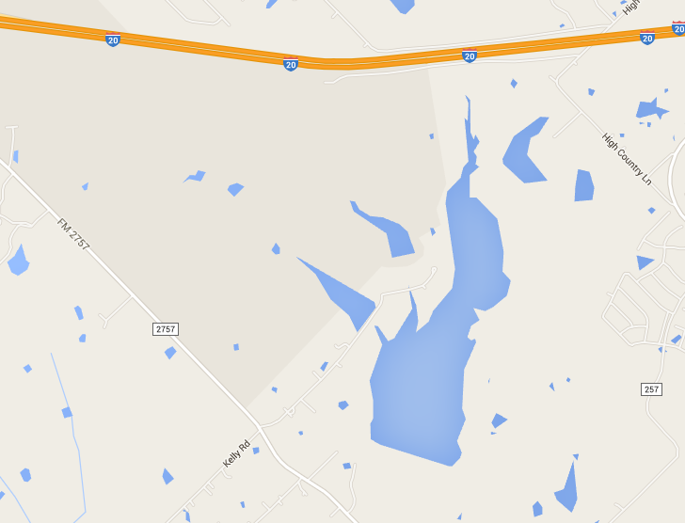
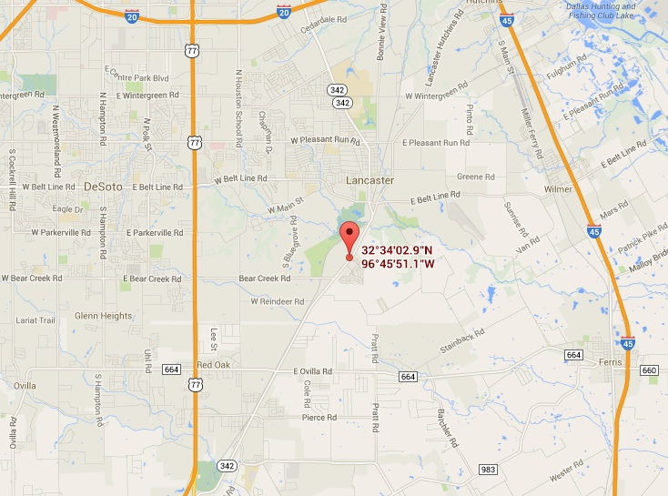
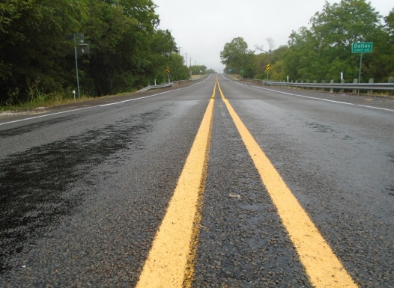
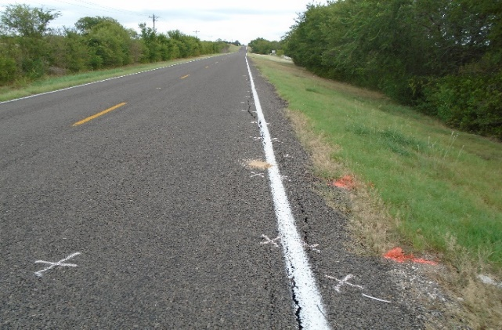
Pavement Site for Field Study
FM 2757, Kaufman County, Dallas, Texas
SH 342, Ellis County, Dallas, Texas

Slide 8
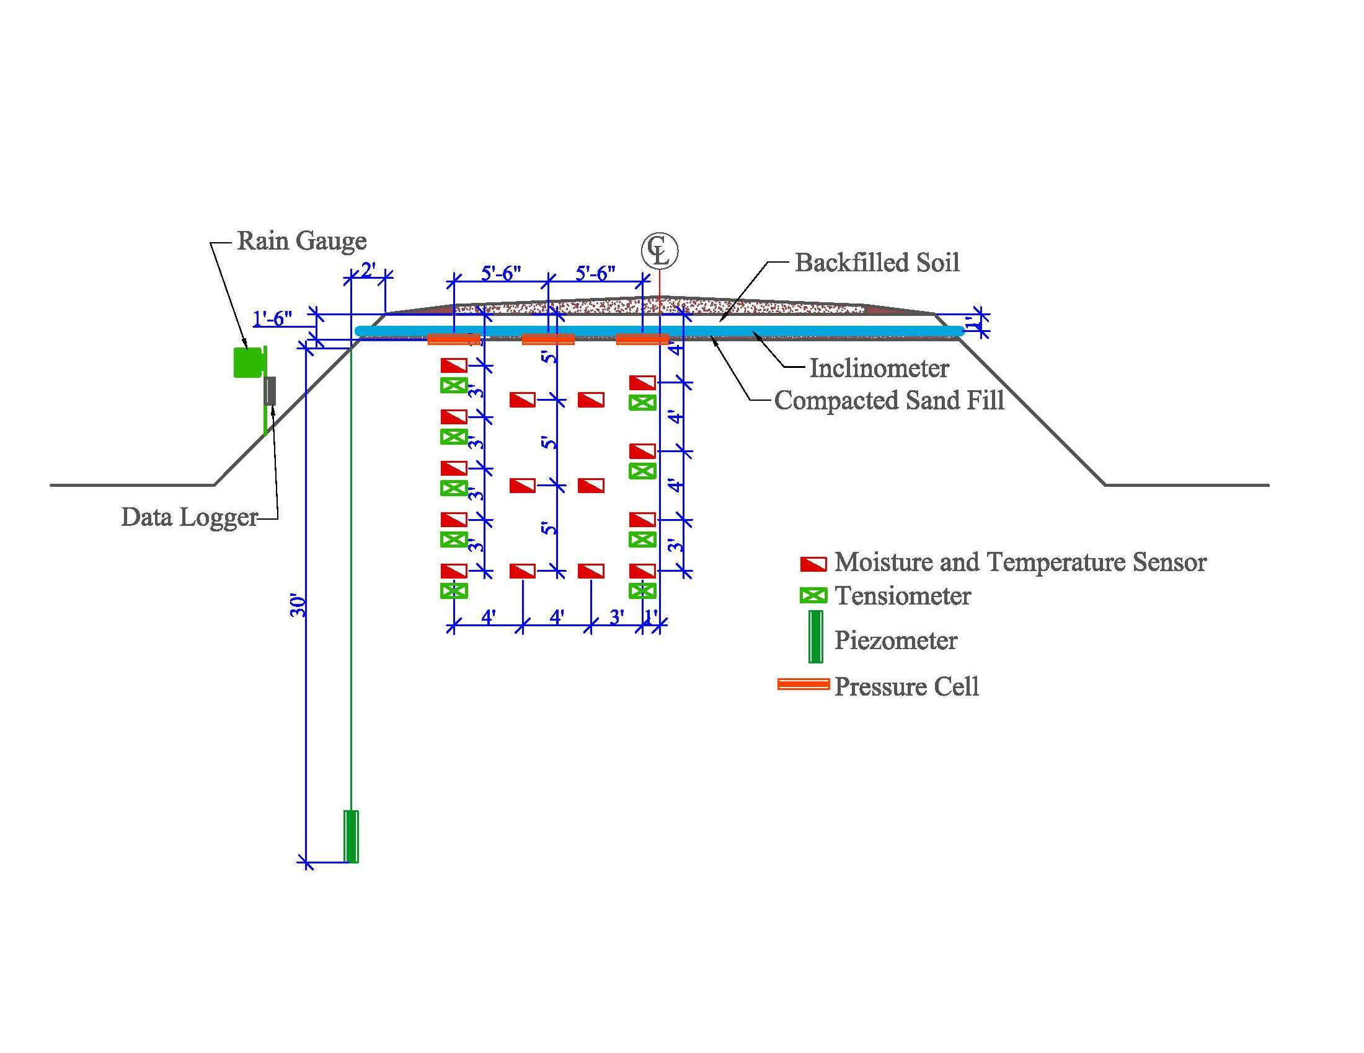
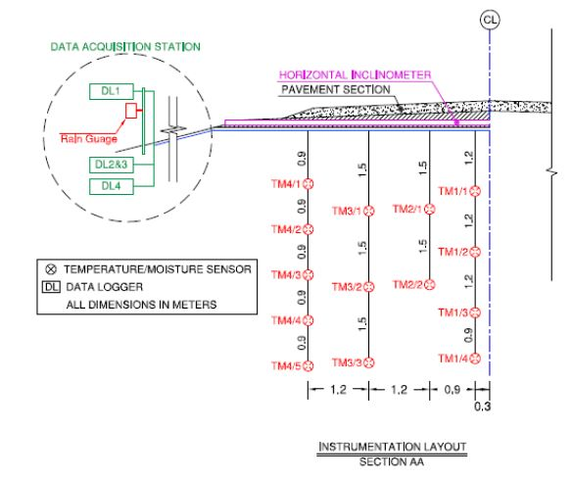
Instrumentation Plan
Moisture and Temperature Sensor
Water Potential Probe
FM 2757, Kaufman County, Dallas, Texas
SH 342, Ellis County, Dallas, Texas

Slide 9
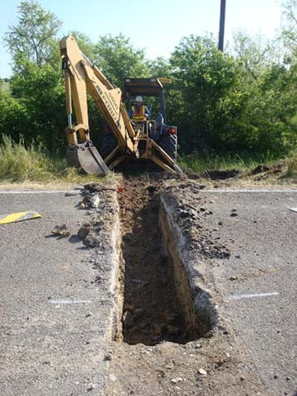
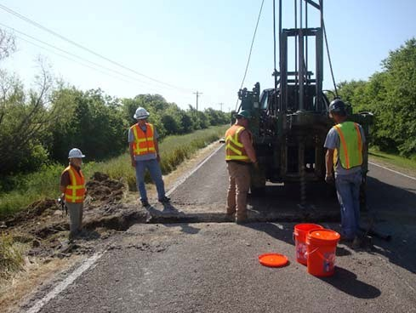
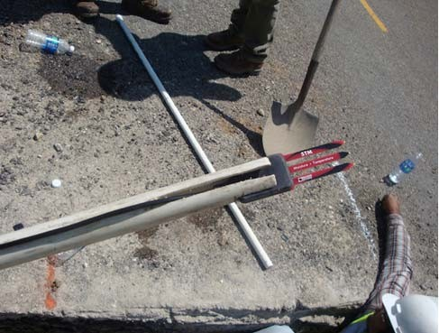
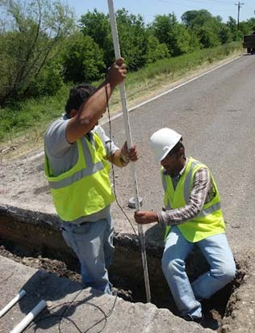
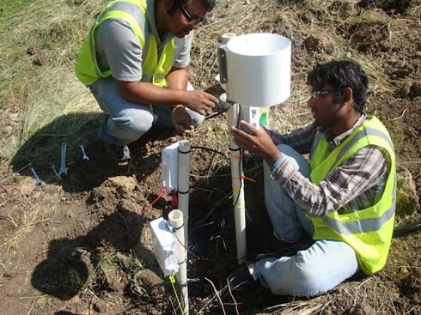
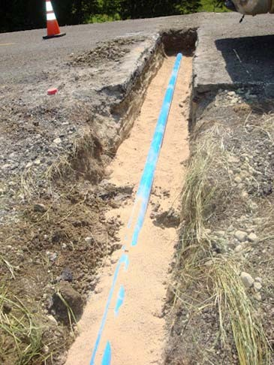
Field Instrumentation: FM 2757

Slide 10
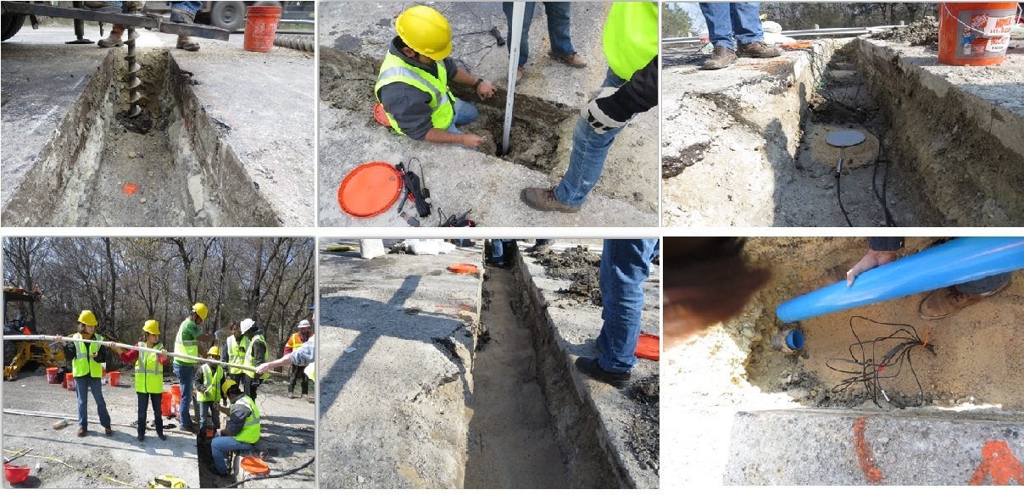
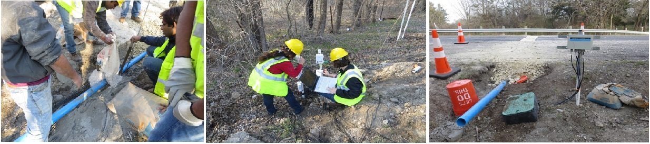
Field Instrumentation: SH 342

Slide 11
Moisture Variation

Slide 12
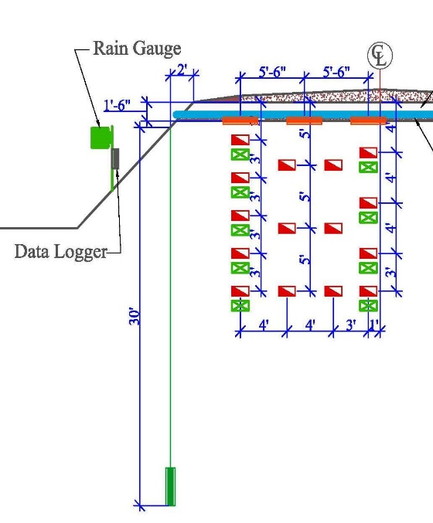
Maximum Moisture Variation
June, 13
August, 13
September, 13
October, 13
January, 14
April, 14

Slide 13
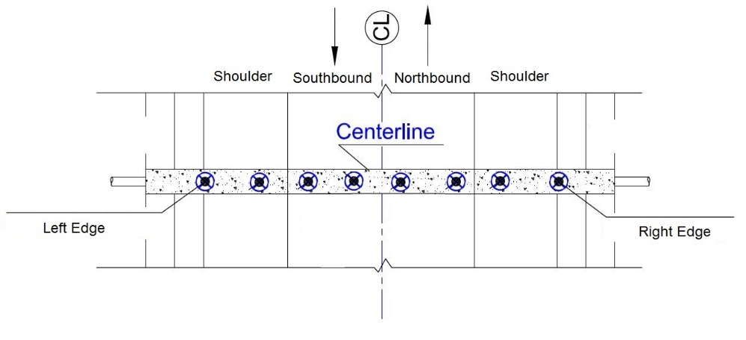
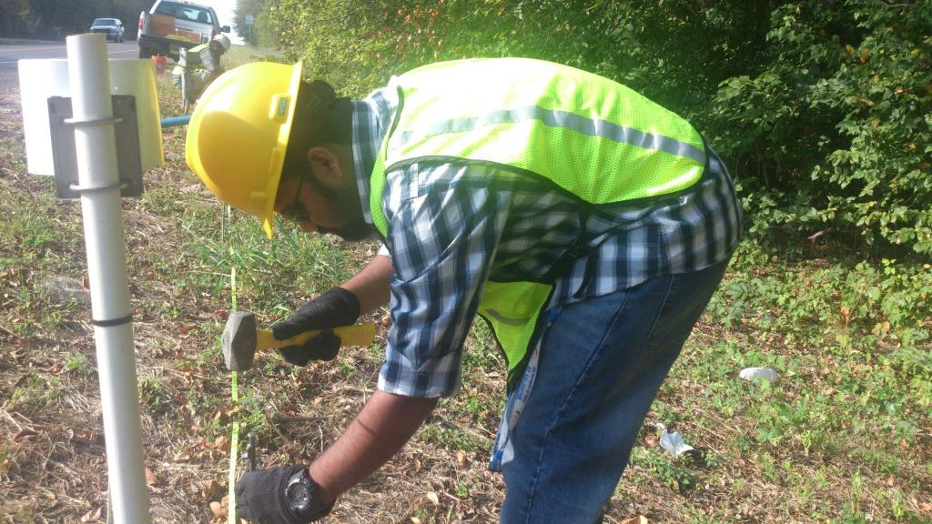
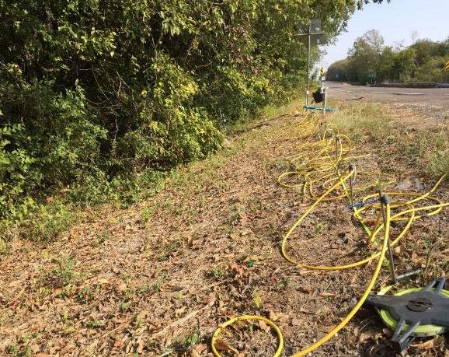
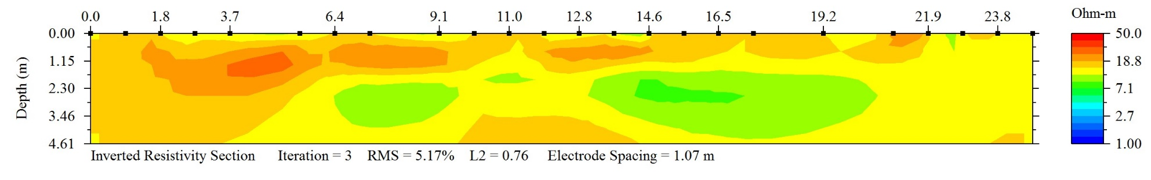
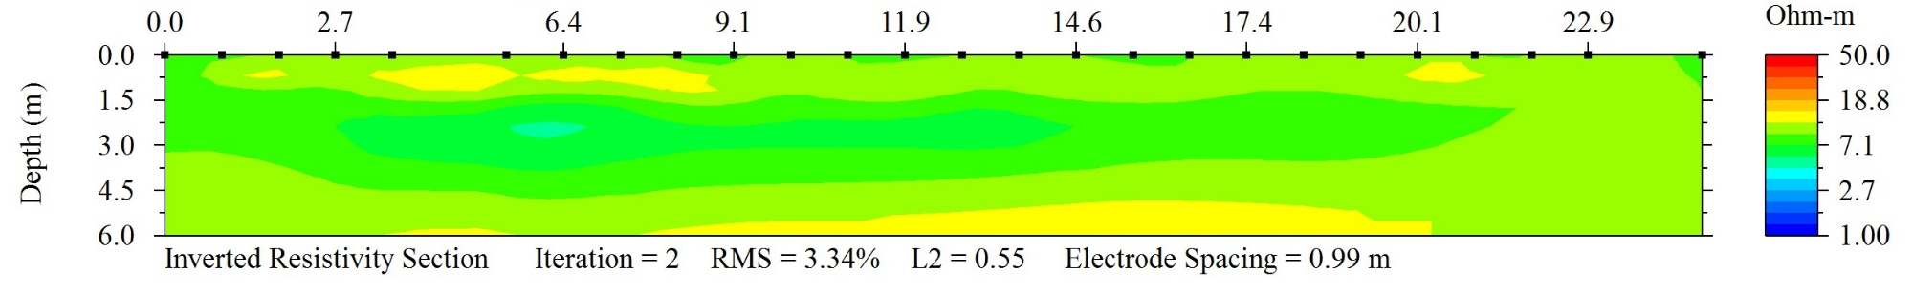
Electrical Resistivity Imaging
Dry Period
Wet Period

Slide 14
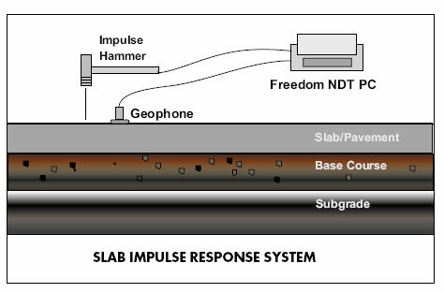
Slab Impulse Response (SIR)
The Slab Impulse Response (Slab IR) method is used to identify and map subgrade voids.
Look for low-stiffness areas associated with hidden damage
  Honeycomb,
  Void
  cracking.
Test Methodology for Slab IR
Surface is impacted with an impulse hammer and the response of the slab is monitored by a geophone placed next to the impact point. The hammer input and the receiver output are recorded.

Slide 15
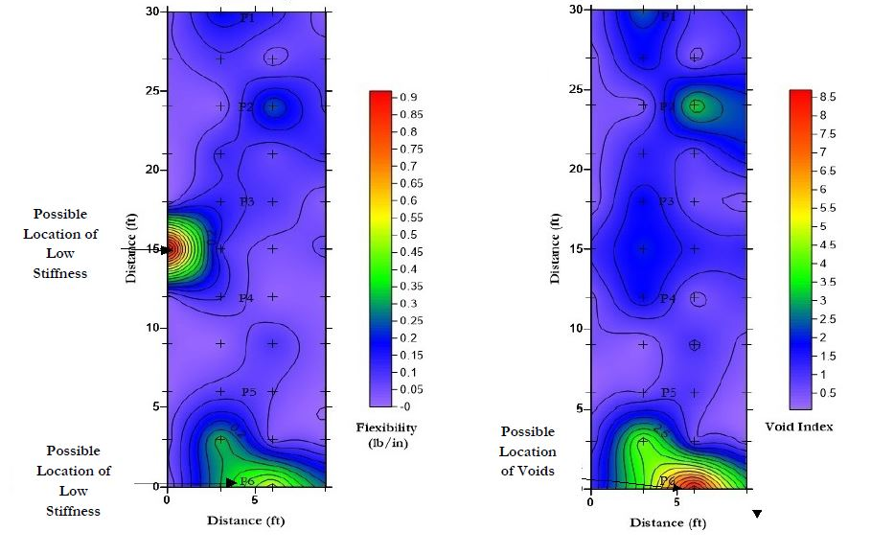
SIR Results
Flexibility
Void Index
  Flexibility: Higher values of flexibility indicates less stiffness and poor support condition.
  Void Index Ratio: Peak to mean ratio greater then 4 indicates poor support condition and voids in the pavement section.

Slide 16
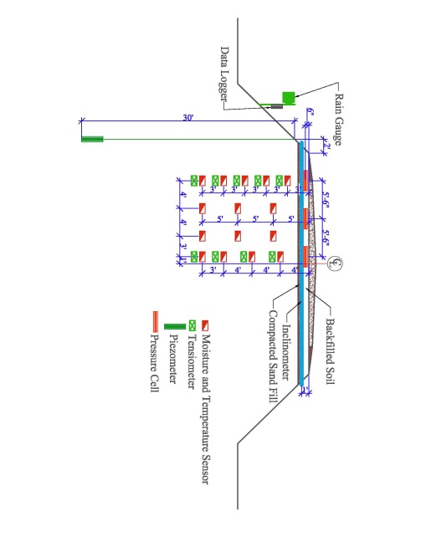
Horizontal Inclinometer Profile

Slide 17
SUSTAINABLE STABILIZATION OF THE HIGHWAY SLOPES FAILURE OVER EXPANSIVE SOIL

Slide 18
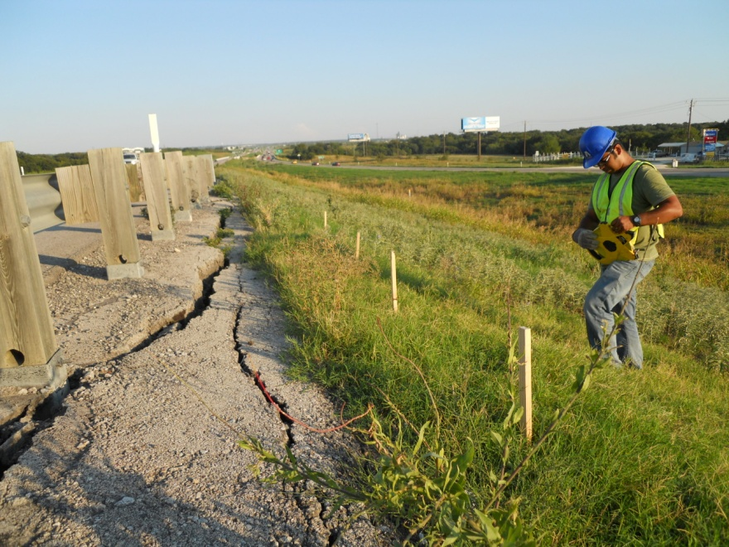
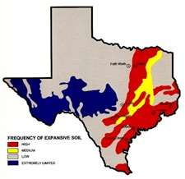
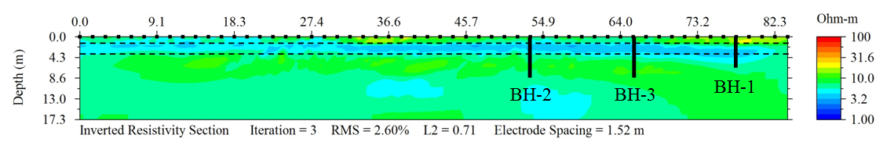
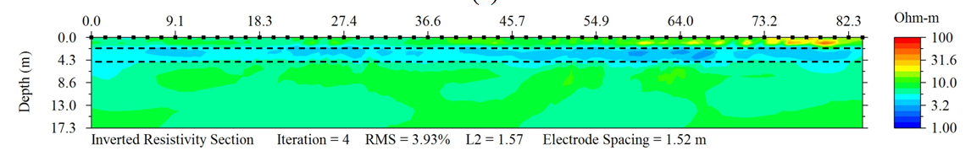
Slope Movement Investigation
Peak O-C
Fully Softened
Peak N-C
Shear Stress
Resistivity Profile: RI-1
Residual
Displacement
Resistivity Profile: RI-2

Slide 19
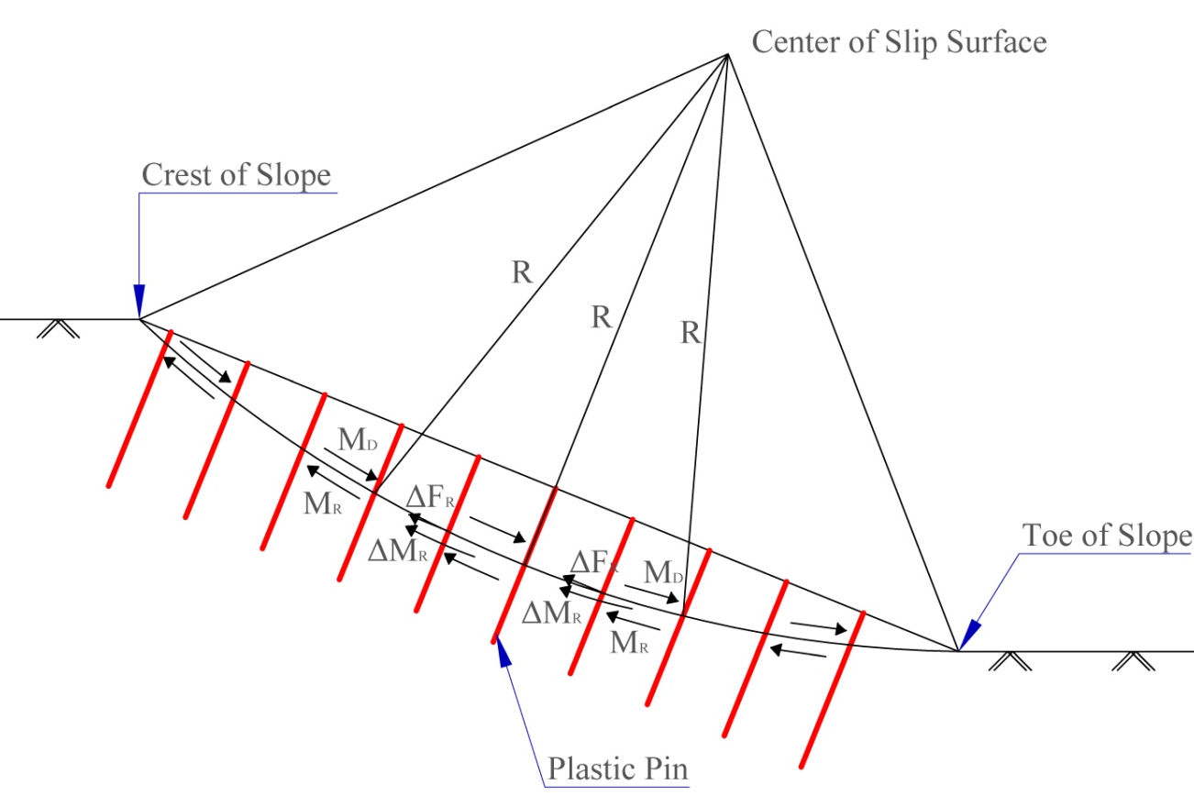
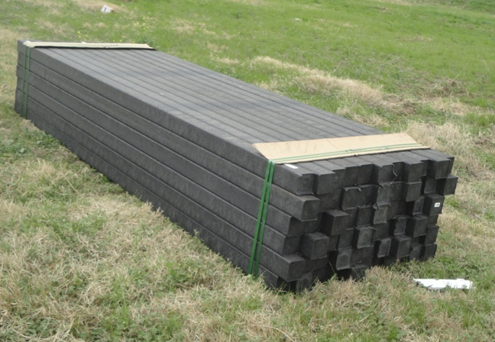

Recycled Plastic Pin to Stabilize Shallow Slope Failure
  50 Billion Water Bottle end up in US Landfill Each Year
  It takes 700 year to decompose plastic bottles
  Ecosystems and wildlife are negatively impacted by plastic debris.
Recycled Plastic Pin (RPP)
  Mainly Polymeric Materials
  Fabricated from Recycled Plastics
  Commercially Available
  RPP Reduces Waste Volume
  Resistant to Biological Exposure
A 10’ long RPP can replace 500 Soda Bottles

Slide 20
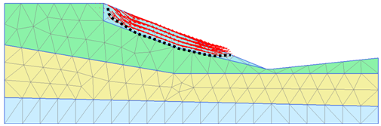
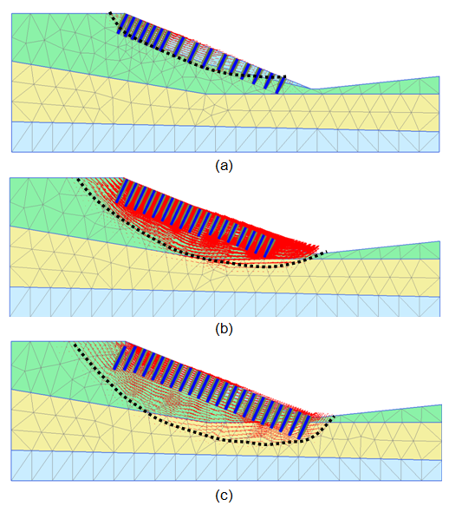
Design of Slope Stabilization
Soil 2
Soil 1
Back Calculated Soil Parameters
Soil Type | Friction Angle | Cohesion | Unit Weight | Elastic Modulus
 | φ | c | ϒ | E
- | ◦ | psf | pcf | psf
1 | 10 | 100 | 125 | 100000
2 | 23 | 100 | 125 | 150000
3 | 15 | 250 | 130 | 200000
4 | 35 | 3000 | 140 | 250000
Soil 3
Soil 4
Back Analysis of Unreinforced Slope: FS = 1.05
Reinforced Section 1: FS = 1.43
Reinforced Section 3: FS = 1.54
Reinforced Section 2: FS = 1.48

Slide 21
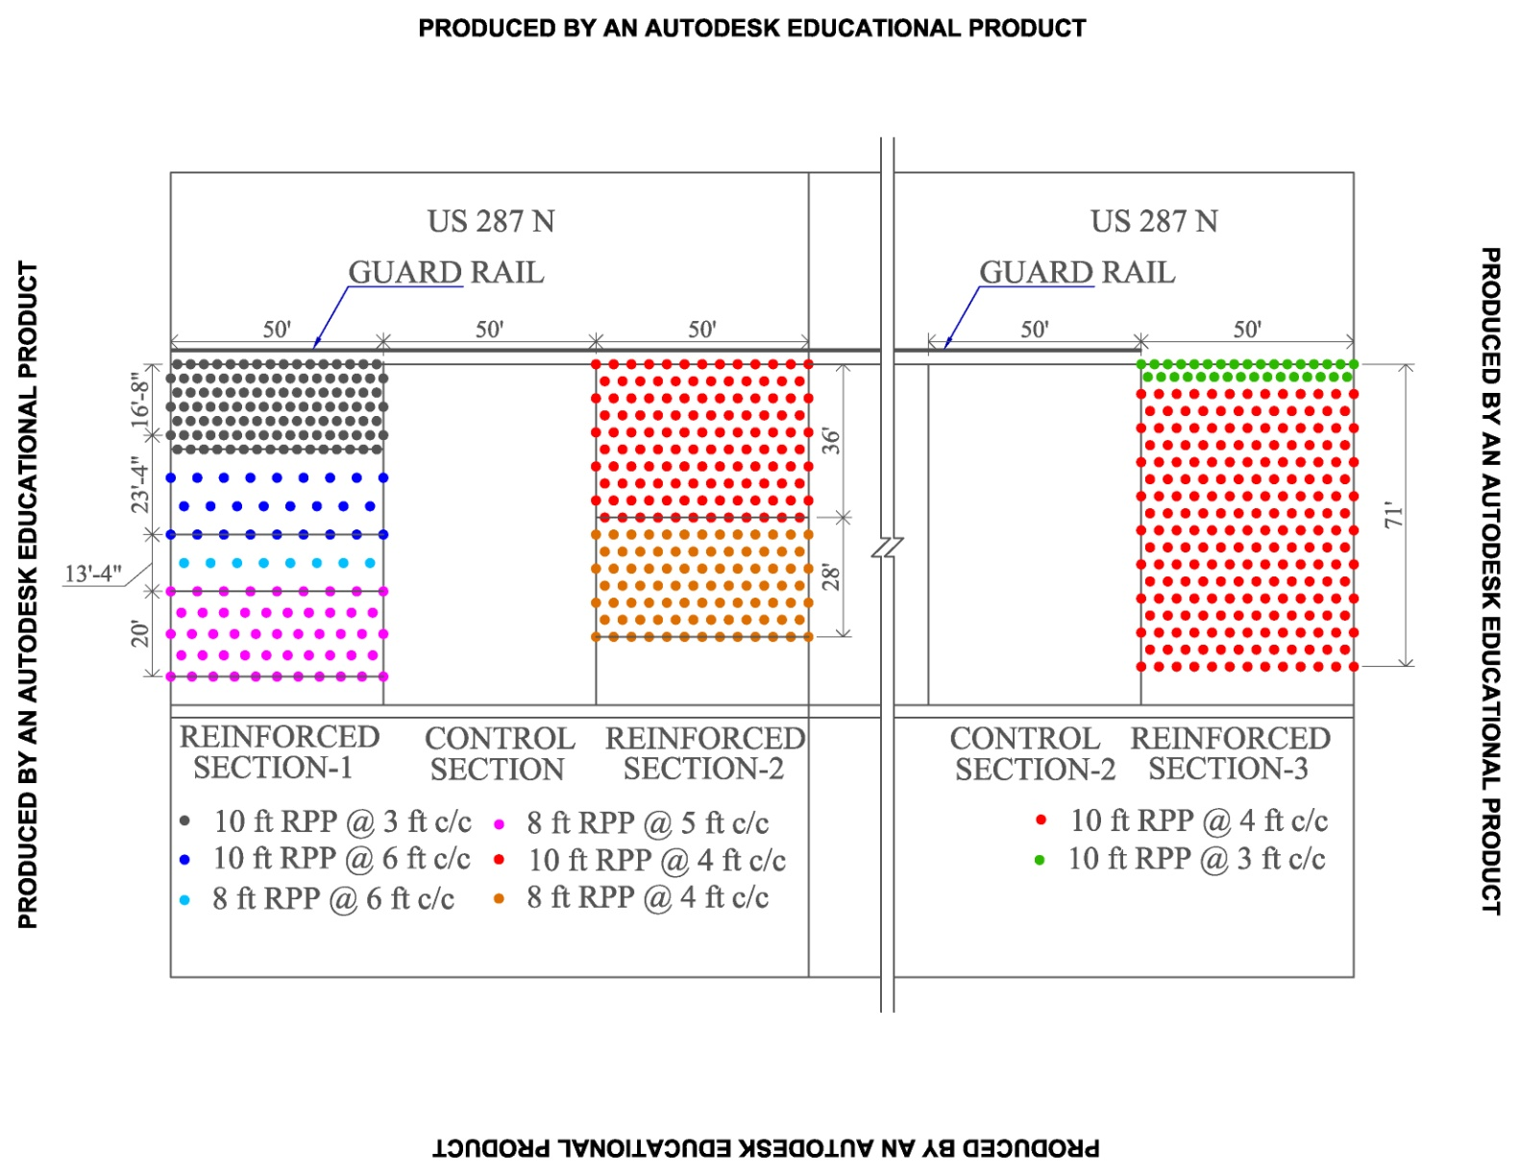
RPP Layout

Slide 22
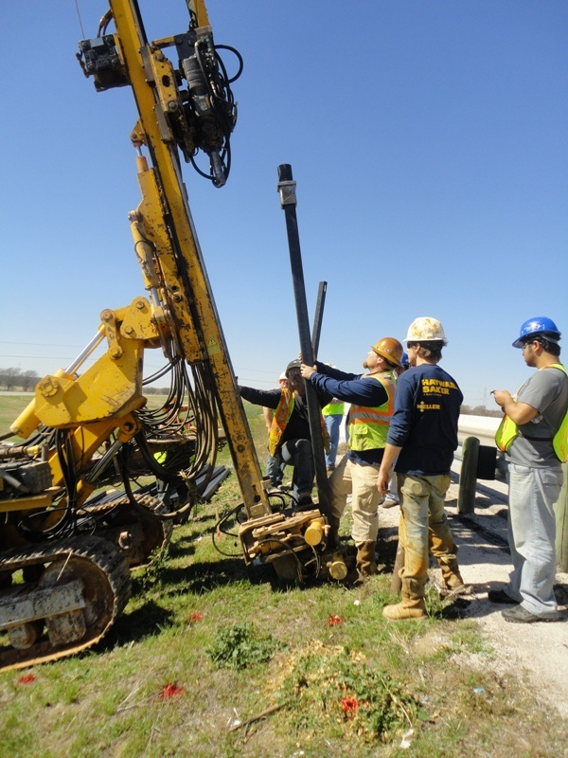
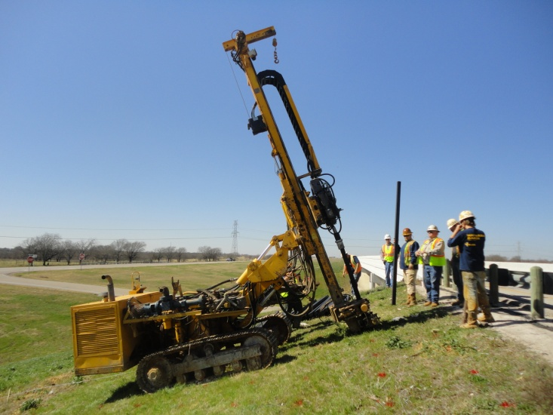
Installation of RPP
Equipment: Klemm 802 Drill Rig
Hammer Type: KD 1101

Slide 23
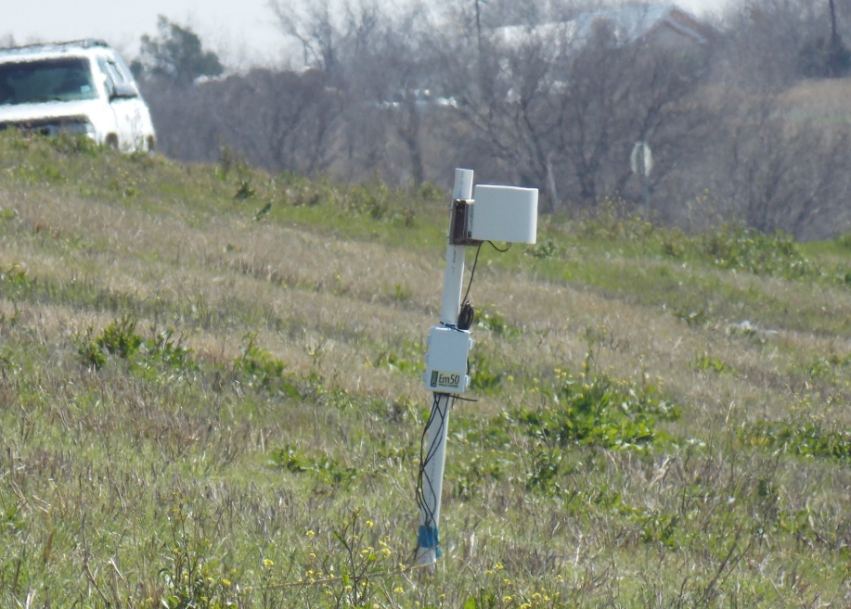
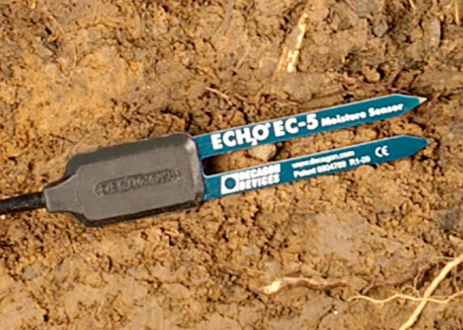
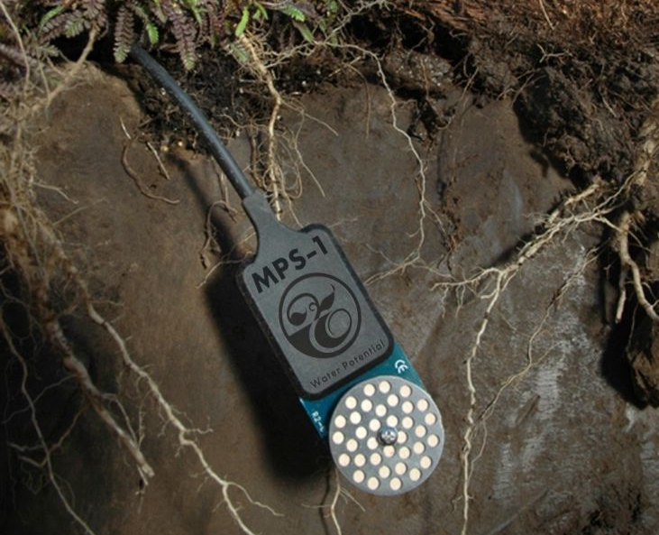
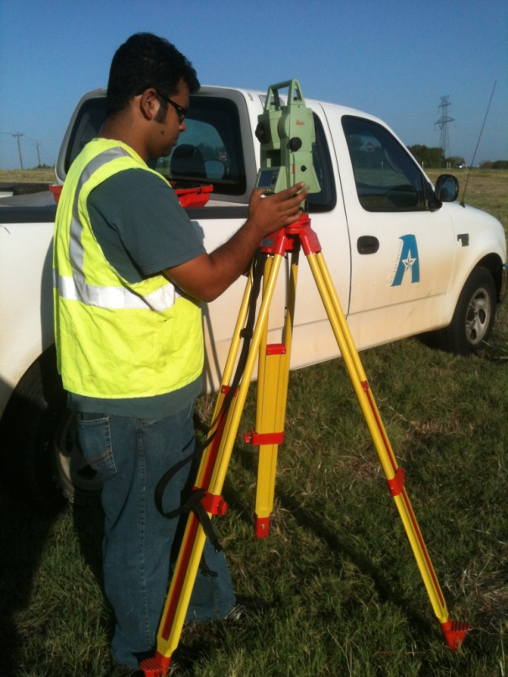
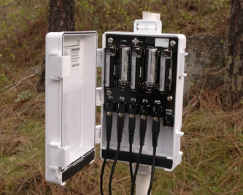
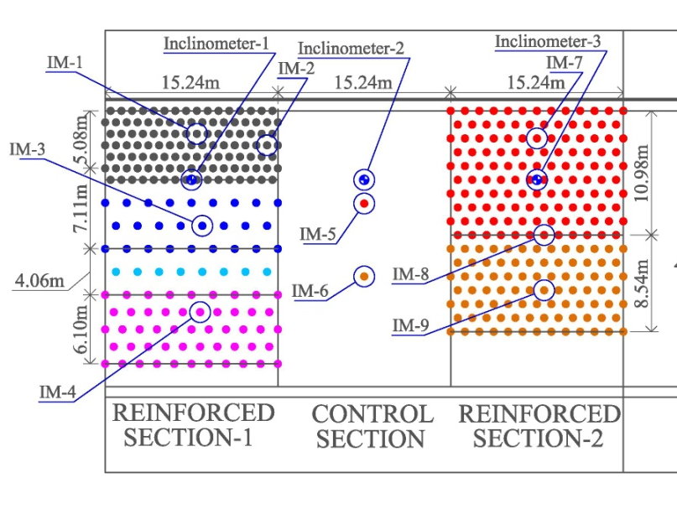
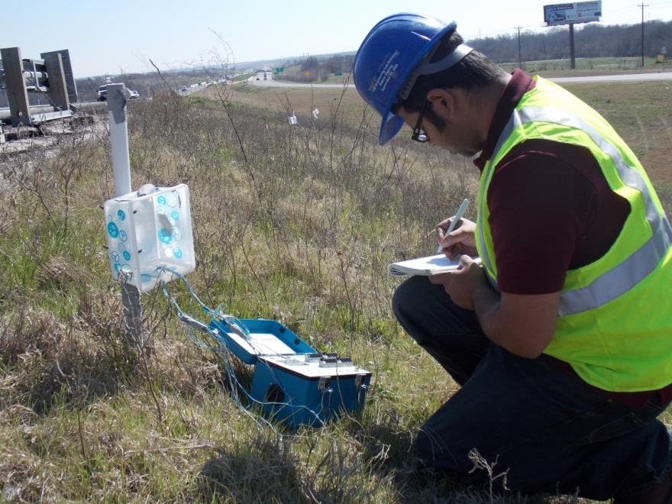
Instrumentation of the Slope
Rain Gauge
Instrumented RPP
Surveying
Inclinometer
Moisture Sensor
Water Potential Probe

Slide 24
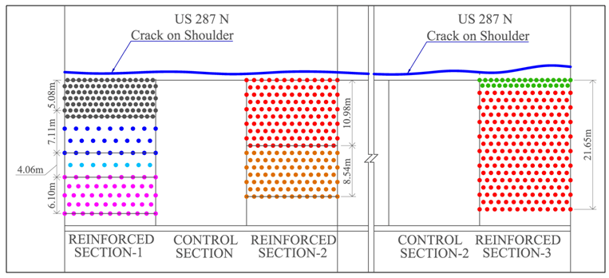
Settlement at Crest

Slide 25
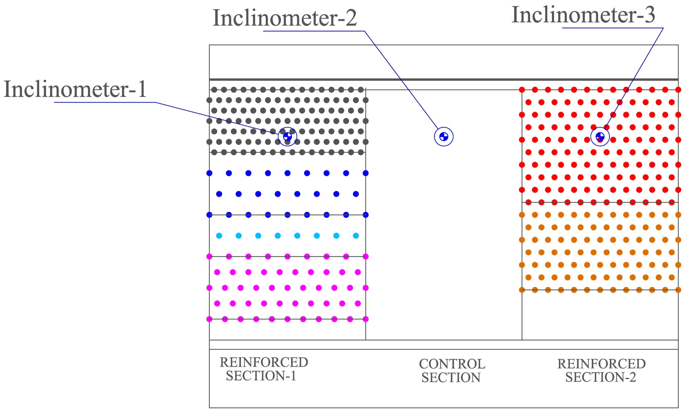
Horizontal Movement

Slide 26
Comparison of Rainfall, Moisture Content, Matric Suction and Hor. Displacement
Rainfall
M/C
Matric Suction
Displacement

Slide 27



Expansive Behavior
Desiccation Crack
(Dry Period)
No Cracks
(Wet Period)

Slide 28




Settlement at Control Section
R. Section 1
Control Section 2
Settlement: 9 in
Control Section
R. Section 3
Settlement: 15 in

Slide 29




Comparison of Performance
Northbound and Southbound (Reinforced) Slope
Failure Location | Time
Failure Location-1 | October 2013
Failure Location -2 | October 2013
Failure Location-3 | June 2015
Failure Location-4 | June 2015
Failure Location 1
Failure Location 2
Failure Location 3
Failure Location 4
Failure Location 3

Slide 30




Failure of Northbound Slope
After Repair
Slope Failed on 1st week of November , 2015

Slide 31




Thank You

